Slide 1
means-ends analysis

Slide 2
Introduction
Means-ends analysis is a technique which can solve major part of the problem first and then the small sub-problems.
It detects the differences between the current state and the goal state.
Based on the differences, a suitable operator is chosen which reduce the differences.
The operator may not be applicable to the current state which creates another sub-goal of reaching to the state where it can be applied. This is called as operator subgoaling.
The operator may also not lead to the actual goal state, then in this case a sub-problem of reaching to the actual goal from the state produced by the operator is created.

Slide 3
GPS(General Problem Solver ) is the first AI technique to use the technique.
Here, the rules are of the following format:
Left side → Right side
Preconditions → Result of rule’s application
A difference table which indexes the rules by the differences is maintained.

Slide 4
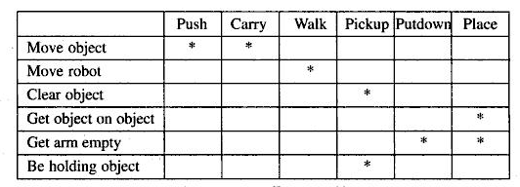
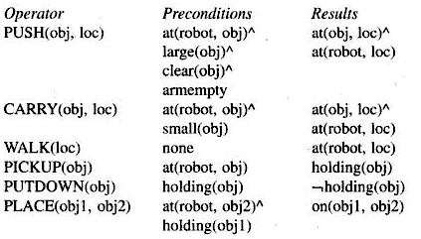
Example
Problem: A Robot has to move a desk with two things on it from one room to another.
Fig 1: Robot’s Operators Fig 2: Difference Table

Slide 5


Fig 3: Progress of means-end analysis

Slide 6
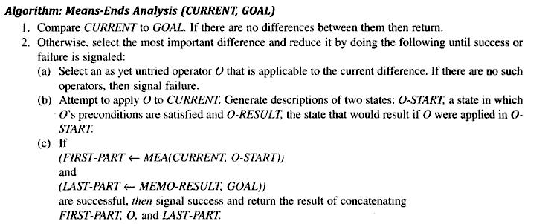

Slide 7


Exercises

Slide 8
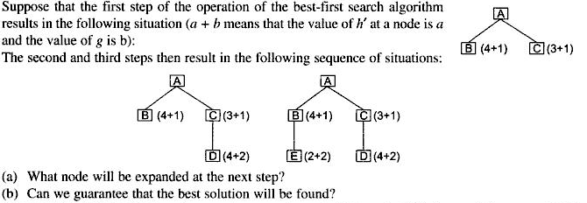
Exercises contd…
4.

